Slide 2
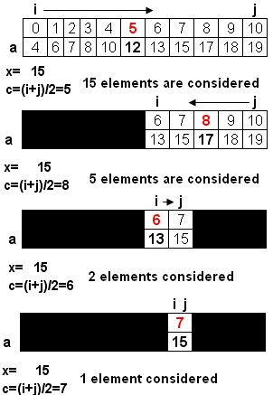
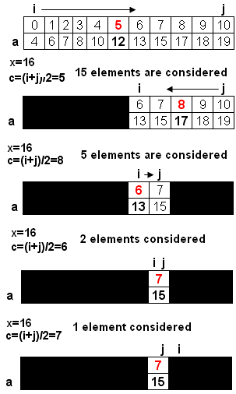
Binary Search
Binary search
- Condition for application: Values in the array were sorted.
return c (7)
i>j → return -1

Slide 3
LINEAR SERACH
Linear search: Find the position of the value x in the array a having n elements.
Search the value of 6 in the array a having 8 items.
5 | 9 | 2 | 7 | 6 | 5 | 2 | 5
i=0 | 1 | 2 | 3 | 4
There may be n comparisons performed.
Search the value of 12 in the array a having 8 items.
5 | 9 | 2 | 7 | 6 | 5 | 2 | 5
i=0 | 1 | 2 | 3 | 4 | 5 | 6 | 7
-1
int firstLinearSearch ( int x, int a[], int n)
{ int i;
for ( i=0; i<n; i++)
if ( x == a[i] ) return i;
return -1;
}
int lastLinearSearch ( double x, double *a, int n)
{ int i;
for ( i=n-1; i>=0; i--)
if ( x == a[i] ) return i;
return -1;
}

Slide 4
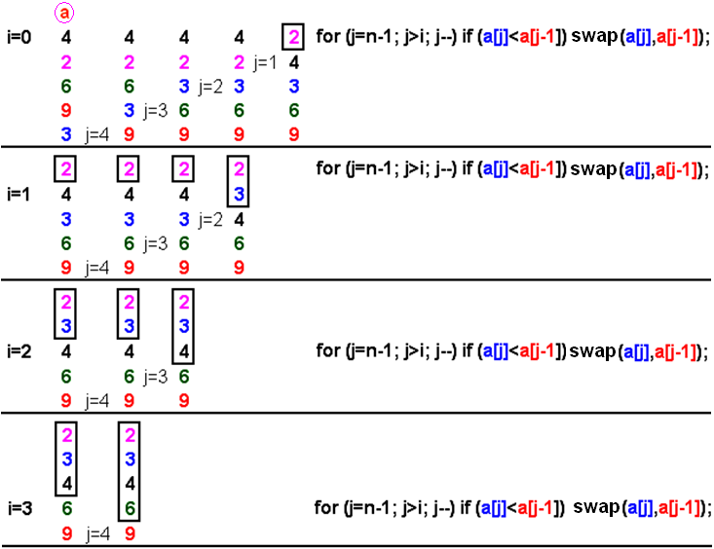
Bubble Sort
It works by repeatedly stepping through the list to be sorted, comparing two items at a time and swapping them if they are in the wrong order.
The pass through the list is repeated until no swaps are needed, which means the list is sorted

Slide 5
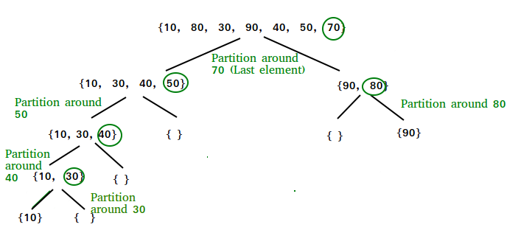
QUICK SORT
QuickSort is a sorting algorithm based on the Divide and Conquer algorithm that picks an element as a pivot and partitions the given array around the picked pivot by placing the pivot in its correct position in the sorted array.

